Slide 1
Grocery Sales Management System
By - Krupal_Prajapati

Slide 2
Introduction :-
In today's data-driven world, effective management and analysis are key to business success. MySQL project, Grocery Sales Management System, is a comprehensive database solution for grocery retailers, handling products, customers, sales, and stock efficiently.
This project demonstrates my SQL skills through advanced features like dynamic queries, stored procedures, and triggers, delivering both seamless operations and actionable insights for real-world business needs.

Slide 3
Database Creation :-
Creating Table :-
CREATE DATABASE GrocerySales;
USE GrocerySales;
CREATE TABLE Products (
ProductID INT AUTO_INCREMENT PRIMARY KEY,
ProductName VARCHAR(255) NOT NULL,
Category VARCHAR(100),
Price DECIMAL(10, 2) NOT NULL,
Stock INT NOT NULL
);
CREATE TABLE Customers (
CustomerID INT AUTO_INCREMENT PRIMARY KEY,
CustomerName VARCHAR(255) NOT NULL,
ContactNumber VARCHAR(15),
Email VARCHAR(255),
Address VARCHAR(500)
);

Slide 4
CREATE TABLE Sales (
SaleID INT AUTO_INCREMENT PRIMARY KEY,
CustomerID INT,
ProductID INT,
Quantity INT NOT NULL,
TotalAmount DECIMAL(10, 2) NOT NULL,
SaleDate DATE NOT NULL,
FOREIGN KEY (CustomerID) REFERENCES Customers(CustomerID),
FOREIGN KEY (ProductID) REFERENCES Products(ProductID)
);
CREATE TABLE CustomerLog (
LogID INT AUTO_INCREMENT PRIMARY KEY,
CustomerID INT,
CustomerName VARCHAR(255),
DeletedAt TIMESTAMP DEFAULT CURRENT_TIMESTAMP
);
CREATE TABLE SalesAudit (
AuditID INT AUTO_INCREMENT PRIMARY KEY,
SaleID INT,
OldQuantity INT,
NewQuantity INT,
ChangeDate TIMESTAMP DEFAULT CURRENT_TIMESTAMP
);

Slide 5
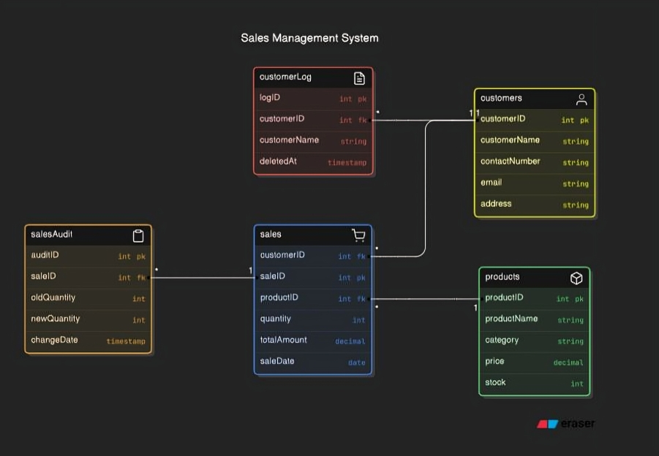
ER Diagram

Slide 6

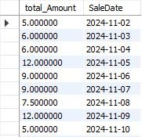
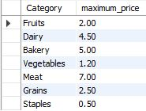
Simple Query :-
1) List the products that have a stock less than 100
select stock , ProductName from products where stock < 100;
2) Find the average sales per day
select Avg(TotalAmount) , SaleDate from sales
group by saleDate;
3) find the most expensive product in each category
select Category, max(price) as maximum_price from products
group by Category;

Slide 7


4) List all products in a specific category (e.g., Dairy)
SELECT ProductName , Price , Stock
FROM Products
WHERE Category = 'Dairy';
5) Find the number of customers who bought more than 1 different products
select customerID, count(distinct productID) as Total_order from sales
group by customerID
having Total_order > 1;

Slide 8

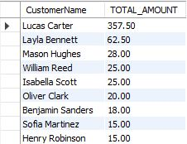
Reporting Queries :-
6) Find the customer who made the most purchases
select c.CustomerID , c.customerName,SUM(s.TotalAmount) as total_spent from sales s
join Customers c on c.CustomerID = s.CustomerID
Group by c.CustomerID
order by total_spent desc
limit 1;
7) Find the total sales for each customer
select sum(s.TotalAmount) as TOTAL_AMOUNT, c.CustomerName from customers c
join sales s on c.CustomerID = s.CustomerID
Group by C.CustomerID;

Slide 9
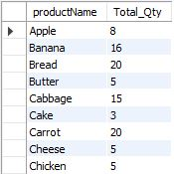
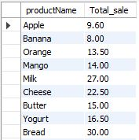
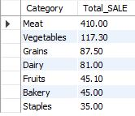
8) Get the details of the top-selling products by total quantity sold
select p.productName , sum(s.quantity) as Total_Qty from sales s
join products p on p.productID = s.productID
group by p.productID
order by Total_qty Desc;
9) Display the total sales amount for each product
select p.productName , sum(s.TotalAmount) as Total_sale from sales s
join products p on s.ProductID = p.ProductID group by p.productName;
10) Get the total sales amount for each category
select p.Category , sum(TotalAmount) as Total_SALE from sales s
join products p on p.productID = s.productID
group by p.Category
order by Total_SALE DESC;

Slide 10

PROCEDURE :- .
SHOW_CUSTOMER_BY_PRODUCT
→ procedure which takes a input of the product and reflect the customers name who brought the product
DELIMITER //
CREATE PROCEDURE SHOW_CUSTOMER_BY_PRODUCT(PRODUCT_NAME VARCHAR(20))
BEGIN
SELECT c.CustomerName from sales s
join customers c on s.CustomerID = c.CustomerID
join products p on s.ProductID = p.ProductID
where p.productName = PRODUCT_NAME;
END //
DELIMITER ;
call grocerysales.SHOW_CUSTOMER_BY_PRODUCT('Fish');
OUTPUT

Slide 11


2) Restock_product:-
→ A procedure which Restock the product stock
Delimiter //
create procedure Restock_product(prod_name varchar(20),restock_value int)
begin
UPDATE products
SET
Stock = Stock + restock_value
WHERE
ProductName = prod_name;
end //
delimiter ;
call grocerysales.Restock_product('Cake', 30);
Before REStock
After REStock

Slide 12



3) Daily_Sales_Report :-
→ A procedure which gives you daily Sales Report
Delimiter //
create Procedure Daily_Sales_Report (report_date date)
begin
select p.productName , sum(s.Quantity) as Total_QTY , sum(s.TotalAmount) AS total_sale from sales s
join products p on p.productID = s.productID
where saleDate = report_date
group by p.productID;
end //
delimiter ;
call grocerysales.Daily_Sales_Report('2024-12-06');
call grocerysales.Daily_Sales_Report('2024-12-07');
call grocerysales.Daily_Sales_Report('2024-12-08');
Report of 2024-12-06
Report of 2024-12-07
Report of 2024-12-08

Slide 13

Trigger :-
14) Create such a trigger which store the logs of Deleted customers
delimiter //
CREATE TRIGGER LogCustomerDeletion
AFTER DELETE ON Customers
FOR EACH ROW
BEGIN
INSERT INTO CustomerLog (CustomerID, CustomerName)
VALUES (OLD.CustomerID, OLD.CustomerName);
END;
delete FROM customers where CustomerID = 1;
OUTPUT : :-

Slide 14
15) Create such a trigger which store the logs of updated quentity of saled Product :-
delimiter //
CREATE TRIGGER TrackSalesUpdates
BEFORE UPDATE ON Sales
FOR EACH ROW
BEGIN
INSERT INTO SalesAudit (SaleID, OldQuantity, NewQuantity)
VALUES (OLD.SaleID, OLD.Quantity, NEW.Quantity);
END;
update sales set quantity = 10 where saleID = 10;
OUTPUT : :-

Slide 15
THE END

